Slide 1
System Development Methods CT00046-3-2
System Design – Part 1

Slide 2
Topic & Structure of the Lesson
System design and contrast it with system analysis.
Systems design guidelines.
System design areas.

Slide 3
Learning Outcomes
At the end of the module, you should be able to:
Describe system design and contrast it with system analysis.
Discuss systems design guidelines.
Identify system design areas.

Slide 4
Key Terms you must be able to use
If you have mastered this topic, you should be able to use the following terms correctly in your assignments and exams:
System design and contrast it with system analysis.
Systems design guidelines.
System design areas.

Slide 5
Systems design and contrast it with systems analysis

Slide 6
Analysis vs Design
Analysis focuses on what system should do— business requirements
Design is oriented toward how system will be built —defining structural components

Slide 7
Analysis vs Design (continued)
Analysis Objectives versus Design Objectives

Slide 8
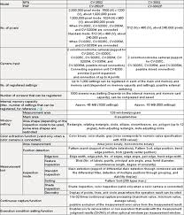
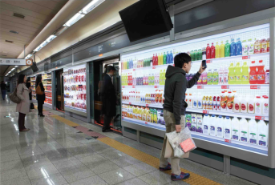
System Design
Design is the bridge between the requirements and the actual implementation.
Definition and structure of components for implementation

Slide 9
System Design (continued)
System Design
Process of defining the architecture, components, modules, interfaces, and data for a system to satisfy specified requirements (a.k.a system modelling)
System Design in a typical software project:
Input – System Requirements Specification (SRS)
Output – System Design Specification.
Has details about what to design
Created by designers for programmers.

Slide 10

System Design Objectives
To create a solution to a problem.
To break down and understand complex concepts and processes.
To create a product safe and secure for use (HCI).
To add vital details to the product.
To come up with an efficient and effective product/solution
To ensure product compliance with set specifications and standards.
To implement modern technology into products.
To test products early and avoid costly rework.

Slide 11
System Design Guidelines

Slide 12
System Design Guidelines
Because the components of a system are interdependent, the design phase is not a series of clearly defined steps. Although you might start in one area, you could find yourself working with several different elements at the same time.
For example, a decision to change a report format might require changes in data design or input screens. Your design checklist will include the user interface, input and output procedures, data design, and system architecture. The final steps are to prepare a systems design specification and present the results to management.
Review system requirements.
Design the system.
Deliver a management presentation.
Create a system design specification.

Slide 13
System Design Guidelines (continued)
Review system requirements.
Study and carefully understand the system requirements document

Slide 14
System Design Guidelines (continued)
Design the system.
The user interface, output, and input issues.
Design an overall user interface, including screens, commands, controls, and features that enable users to interact with an application.
Determine how data will enter the system, and design necessary source documents.
Design the physical layout for input and output forms and
reports, including screens and printed reports.
Data issues
Determine how data will be organized, stored, maintained, updated, accessed, and used.
System architecture issues
Determine processing strategies and methods, client/server interaction, network configuration, and Internet/intranet interface issues.

Slide 15
System Design Guidelines (continued)
Create a system design specification.
Develop a systems design specification that describes and documents the proposed design.
Deliver a management presentation.
Include a progress report, a budget update, and a timetable for system implementation and operation.

Slide 16
Systems design areas

Slide 17
System Design Areas
In general, system design is divided into high-level design and low-level design as follow:
High Level Design
Broad design of the overall system structure
Software Design
Low level design that includes the design of the specific program details
Conceptual Design
System Architecture
Hardware, Software, Network, etc.
Logical Design
Physical Design

Slide 18
System Architecture
A high-level view of the system where the developer needs to determine:
The types of users
Environment (Different ‘views’ of the system)
Behavior of the system
Availability of technology
The platform
Laws and Legislations
Industry Standards and Protocols
Security
Network and connectivity
Maintenance

Slide 19
System Architecture Three Layer Architecture
An effective method of software design
A client/server architecture that divides an application into three layers:
View layer
Contains the user interface
Business logic layer or domain layer
Contains the programs that implement the business rules and processes
Data layer
Manages the stored data
Accepts user inputs and displays results

Slide 20
Abstract Three Layer Architecture
Advantages:
Layers are independent of each other
Layers can exist on the same or different computers
Flexibility to add hardware/software components to each layer
System capacity can be increased by splitting layer functions or load sharing across redundant computers

Slide 21
Internal Deployment with Three Layer Architecture

Slide 22
Software and Hardware Architecture
Subcomponent of System Architectures.
Developers need to be concerned of:
Operating system and versions
Input / output requirements
Storage requirements
Processing requirements
Interfaces (including GUI)
Security, System control and backup or recovery
System support

Slide 23
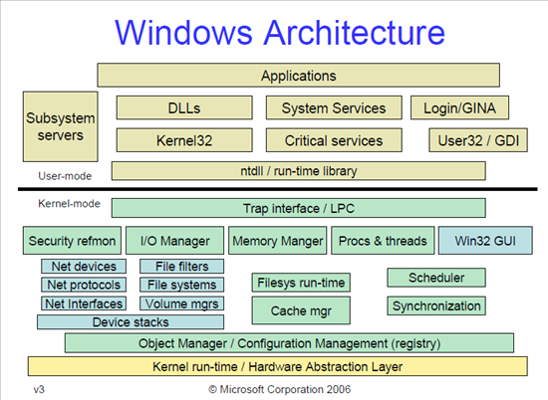
Software Architecture example

Slide 24
Conceptual Design
Understanding and presenting the concept of the product
Usually to non-IT people, users, customers, etc.
Contains basic information, major process and components only.
Examples (in IT projects):
Context Diagram
Use Case Diagram
Flow Chart
Story Board
Rich Picture
Posters, etc.

Slide 25
Logical Design
Abstract of the system, usually presented in diagrams (models)
Process Design
Data Design
Examples (in IT projects):
Data Flow Diagram
Entity Relations Diagram
UML – Activity Diagram
UML – Class Diagrams, etc.

Slide 26
Physical Design
Enhanced presentation of the design, usually graphical presentation of the product
Usually presented as:
Input-output of the system for users via GUI
Input–process-output for developers
Popular type of Physical Design
Prototype: an early sample, model or release of a product created to test a concept or process
Simulation, Animation, Video - allow users to observe an operation through simulation without actually performing that operation

Slide 27
Prototyping
Process of creating a model (prototype) of the system.
Features:
Only shows the main interface, functions and features.
Advantages:
‘3D’ view of product, capture more problems / opinions
Display for early user feedback / confirmation / satisfaction.
Disadvantages:
It may cost money and time to create / modify
Developer unclear of the scope of the prototype (end-up over doing it)
Not all functions can be seen in a prototype.

Slide 28
Dimensions of Prototyping
Horizontal prototype
The prototype provides a broad view of an entire system or subsystem
Focusing on user interaction more than low-level system functionality, such as database access.
Useful for demonstration to users and estimating project.
Vertical prototype
Prototype elaborates a single subsystem or function.
It is useful for obtaining detailed requirements for a given function, such as refinement database design.
Useful for study and testing.

Slide 29
Types of Prototype
Throw-away Prototype
The basic form of the prototype, created for demonstration purposes.
Only shows a‘ dummy’ representation of the actual product.
Evolutionary Prototype
The entire product is built in stages based on added / changing requirements.
Commonly this prototype is developed to become the final product.
Incremental Prototype
Several prototypes and merged and refined to become the final product.
Extreme Prototype
Widely used for Web Development.
Product is delivered in fully functional scale, by stages:
Stage 1 - Usually Static Pages (HTML)
Stage 2 – All Functions (Coding)
Stage 3- Other services/components such as a database.

Slide 30
What makes good design
Creativity and innovation
Finding ways / ideas to improve design
Good development tools
Using latest software to construct, test and present design
Experience
Improvement of skill
Commitment to high quality
Comply with design standards and principles
Fast changes to demand and environment
R&D

Slide 31
Good Design Practices
The design process should not suffer from "tunnel vision."
not taking everything into account when producing a software solution due to lack of knowledge
A good designer should consider alternative approaches.
The design should be traceable to the analysis model.
The design should not reinvent the wheel.
The design should be structured to accommodate change.
The design should be assessed for quality.

Slide 32
Summary
System analysis focuses on what the system should do/business requirements. Whilst system design is oriented toward how the system will be built/defining structural components.
System design is a process of defining the architecture, components, modules, interfaces, and data for a system to satisfy specified requirements (a.k.a system modelling).
The high-level design provides the broad design of the overall system structure (e.g., System Architecture diagram).
The low-level design includes the design of the specific program details including conceptual, logical, and physical designs.
System design should take everything into account when producing a software solution, consider alternative approaches, traceable, not reinvent the wheel, structured to accommodate change and be assessed for quality.

Slide 33
Question & Answer

Slide 34
Next Session
System Design Part 2

